Slide 1
Containerizing Notebooks for Serverless Execution
Kevin M. McCormick
Amazon SageMaker, Sr. Engineer
JupyterCon, NYC, 2018

Slide 2
Welcome!
?
?
?
?
What a “containerized” notebook or kernel?
What is it good for?
How does it work?
How can I get started?
Notes:
Hi everyone. My name is Kevin, I’m an engineer on the Amazon SageMaker team, and I’m here to tell you a little bit about a few interesting things that we’ve been doing with Jupyter these days behind the scenes. As some of you already might know, Jupyter’s an important part of the Amazon SageMaker product, but since we’ve gotten to know Jupyter quite a bit better over the past few years, since building the product, we’re also trying new things along way to do with Jupyter. One of these things is what we call “Kernel Containerization” or “Notebook Containerization”, and I’d like to tell a little bit of a story of what we’ve done.
By the end of this talk, I hope you can walk away with a better understanding of the following four things:
First, what a containerized notebook and kernel is, or at least by my definition.
Second, I’ll go over two use cases I observed internally at AWS where containerization was useful.
Third, I’ll give you an overview of how two different containerization implementations were built, both in an internal experimentation and in a production context.
And lastly, I’ll give you some tips on implementing your own containerization solution, or how to get started with the implementations available to you.
In this talk, I’ll assume that you have a basic understanding of how Jupyter Kernels and Docker containers work. I’ll do a couple of deep dives for those who might find it interesting, but don’t worry, none of this will be on the test!

Slide 3





Some Quick Background
Amazon SageMaker
BUILD
TRAIN
DEPLOY
TUNE
AWS IoT Analytics
Notes:
So, before we dive into the nuts and bolts, let me first give you a quick overview of two relevant AWS services in case you aren’t familiar with them. I’ll be mentioning them here and there throughout this talk since both of them employ Jupyter notebooks on AWS.
(next)
The first service I’m going to be mentioning today is Amazon SageMaker. (This is the service I work on.) SageMaker is a fully-managed service which makes it easy to build, train, and deploy Machine Learning models in the cloud. The “build” portion of this diagram is the diagram that I work on (next) it’s hosted Jupyter notebooks! For completeness (and this will be relevant later), SageMaker also includes a few other things: a highly-scalable model training and tuning service, a model hosting service for real-time and batch predictions, and a broad selection of ready-to-use, highly-optimized implementations of popular ML algorithms.
(next)
AWS IoT Analytics is a different AWS offering, which is a fully-managed service that makes it easy to run sophisticated analytics on massive volumes of Internet-of-Things data. Some features of IoT Analytics are integrated with Amazon SageMaker, too. For example, it can automatically create notebook files in SageMaker that are preconfigured to work with IoT data sets. And, also available starting today as a new feature, is the ability to run analytical models composed in IoT-based notebooks on a recurrent schedule. What a coincidence that this new feature is being introduced at our AWS Summit in Anaheim California, the same day as JupyterCon!
Q&A: What is a time-series data store optimized for IoT data?
Q&A: What’s the billing implications of serverless execution?

Slide 4
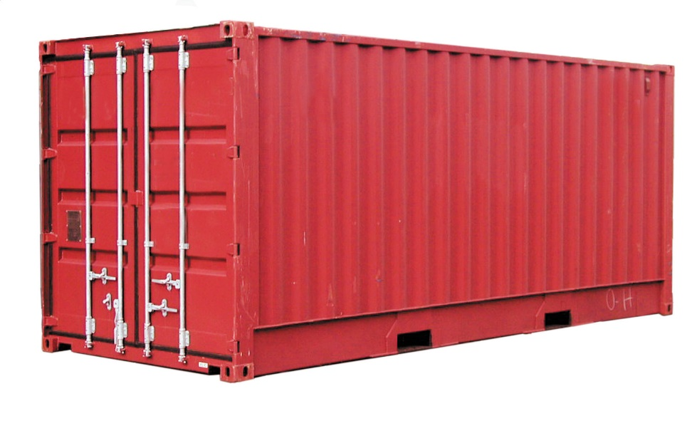
What Goes in a Container?
ubuntu, centos
nbconvert, jupyter
.ipynb files
conda environments
IPython kernel processes
Notes:
So, a lot of people love containers. You can put a lot of things in a container! “Containerizing” in this context of course could mean a lot of things! For example, you can put any of the following in them:
Of course, every container starts with a Dockerfile declaring a base layer, usually an operating system, such as Ubuntu or Amazon Linux
From there, you could automate the installation of applications, such as the Jupyter server or nbconvert. You could also get these applications by baking them into a layer.
Likewise, you can also include notebook files themselves, and maybe even associated data files.
And lastly, you can include your dependencies in your favorite form, such as conda environments (or pip packages).
An addition to these, we also found one more thing that seems to make sense inside of a container, while it’s running, are (next) IPython kernel processes themselves. Since the kernel is where the IPython code actually runs, this provides a lot of convenient properties that allow the associated notebook to be very portable.
So, throughout this talk, when I discuss containerization, I’m really referring to finding the right combination of these ingredients, in steps towards the holy grail of making it very easy to create highly reproducible Jupyter notebooks. By no means have we found this holy grail, but we did at a minimum find some interesting things.

Slide 5

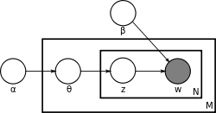


A Tale of Two Davids (and Oleg, and Xiang)
to be continued…
D #1
D #2
O
X
Notes:
OK, so I’ll be telling the “tale of two Davids” at Amazon. These are two software engineers are sitting a few floors apart from each other, both building Docker containers for different reasons. They both ended up deciding to containerize kernels, which is the core focus of this talk.
(next)
The first David is an engineer on the Amazon SageMaker team, working on an optimized implementation of the (next) Latent Dirichlet Allocation algorithm, or “LDA” for short. David’s implementation is partly written in Python, and partly written in C++. At first, beyond writing unit tests to verify basic code correctness, he was running smoke tests to verify improvements in the algorithm’s performance and accuracy, iteration-over-iteration. He used Jupyter Notebooks to run the smoke tests, compare the results visually, record his findings, and use all of the other great features of Jupyter that we all love.
For his smoke tests, he was using the New York Times Annotated Corpus data set. If you’ve never used this data set, it contains over 1.8 million articles written and published over a 30 year period, and includes associated summaries and hand-verified tags. Each smoke test took approximately 8-10 minutes, and would totally hose his desktop while it was running. In other words, the perfect amount of time to fix a proper cup of tea. (next) (For reference, his cloud-based developer desktop has 36 cores, and 60GB of RAM, so this wasn’t exactly a lightweight machine.)
However, he didn’t want to stop with the New York Times dataset. A much more ambitious dataset was a preprocessed version of the Wikipedia Database, (next) which was approximately 10GB of Wikipedia articles tagged in a similar way. Even on his beefy desktop, performing a verification run of LDA on this dataset took up to 6 hours to complete. (David likes tea, but doesn’t need that long of a break!)
Since David’s work was ultimately set to launch as a SageMaker-provided algorithm, he tried to think of a way to actually run his smoke tests directly on SageMaker while he was iterating. (next) This ended up having two advantages: 1) it ensured continuous compatibility with the SageMaker training service, a key requirement of his work, and 2) it would free up his developer desktop for continued development while he was running experiments on different variants of the LDA algorithm. With the additional productivity he found with this technique, knew he’d be able to meet his performance and accuracy goals well before the big re:Invent launch keynote announcement.
So he set out to solve that problem…
The other David (and his teammates) – we’ll come back to them later…

Slide 6

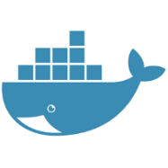



Understanding David #1’s Goal
Jupyter
Notebook
Instances
Model Training
Service
Model Hosting
Service
Amazon SageMaker SDK Containers
Local Storage
.ipynb files, conda environments
TensorFlow, MXNet, Chainer, PyTorch, etc.
Amazon SageMaker Algorithm Containers
Linear Learner, XGBoost, K-Means, PCA, LDA, etc.
Amazon S3
Training Data, Model Artifacts
Your Containers
Straight Python, scikit-learn, OpenCV, C++, etc.
Notes:
So let’s start by taking a deeper look at David’s problem. David was developing the LDA algorithm in a development environment similar to a SageMaker Notebook Instance. On his cloud-based developer environment, he had a copy of Jupyter running as his “dashboard”, as well as a local workspace which contained all of his code – makefiles, C code, and Python files. This workspace made use of an internal build system called Brazil, which Amazonians use to build code and define dependencies.
Since David was actually building a part of SageMaker itself, let me quickly explain the moving parts.
(next)
A SageMaker Notebook Instance, is, well, a mostly unadulterated installation of Jupyter, JupyterLab, the Anaconda Distribution, and most of the deep learning frameworks included in the AWS Deep Learning AMI, such as TensorFlow and MXNet. Back in November, containers were nowhere to be seen – instead, SageMaker users get full root access to the box, and full permission to hack away to their hearts’ content! As a result dependency management is a bit simpler, and is provided primarily by conda and pip.
(next)
However, David’s algorithm was intended to run on the SageMaker training and hosting services, which are both serverless, and are based on Docker. In other words, they require that a compatible Docker image be provided to serve as the “runtime” during the training job run, or to be used to perform inference. Since Docker images are easy to transport, replicate, and offer good versioning semantics, they are ideal for deploying runtime environments, though admittedly leave less room for hacking.
There are three broad categories of Docker image types that are commonly used in SageMaker: (next) 1) A container which has a specific deep learning framework installed, ready to accept a model definition in order to run, (next) 2) One of the pre-built Algorithm containers, or 3) A container totally built from scratch. David happened to be building the second type, but all three are essentially all created in the same way – write code, build it, create a Docker image, upload to a Docker repository (Amazon ECR in this case), and run a SageMaker action using that image ID. It’s this “loop” that David hoped to optimize for personal gain, since shorter loops means more iteration, which means better code.
(next)
Oh, and it case you are wondering, training data, as well as model artifacts are stored in Amazon S3, a general-purpose storage service which is commonly used in AWS.

Slide 7
David #1: What He Hacked Together
KernelSpec that launches IPython within a container
Magics to use as convenience functions for:
  Auto-packaging
  Dispatching cells as SageMaker training jobs
  Comparing training job results
Widgets to browse jobs.
Write Algorithm Code
Build Container
Upload Container
Run Container on SageMaker
Review Algorithm Performance
Notes:
So here’s the 5-step process that was plaguing David. Of course, from his normal build tools, he could certainly build, upload, and run his container in a scripted fashion. However, this is half data-science and half-engineering work – looking at text output simply wasn’t enough, especially since he needed to perform analysis and visualization on the output of each iteration – a perfect use case for Jupyter notebooks. He also wanted to experiment with different hyperparameters, wanted to experiment with different ways of calling his Python code, and so forth, which also seemed more conducive to a notebook instead of continually editing and re-packaging his Python entrypoint scripts. Why not just put that code right in a notebook?
David came up with a clever solution to consolidate his workflow and put the focus on rapid iteration directly in the notebook. So what did he do?
(next)
First, he moved the IPython kernel into a running docker container on his dev desktop. While it took quite a bit of experimenting to get it working, the end result was pretty simple. The list of kernels available in Jupyter is defined in kernel.json files which indicate the command to run when you select that kernel from the Jupyter UI. The normal IPython kernel simply indicates the ipython program and a few additional arguments. In his version, he simply changed this to docker run, and hand-crafted a suitable Dockerfile which launches ‘python –m ipykernel -f’ inside of it.
By moving the kernel inside of a container, he now knew that anything that he could run in that container would also run if he created an image (by calling docker commit), and passing the image on to the SageMaker training service. This included any Python modules which he mounted in the container, such as the algorithm he was writing.
(next)
2. So the second step were a series of cell magics which served as special signals which would trigger a docker commit and re-write of the Dockerfile’s entrypoint, so that the specific cell that was run was invoked the next time the container was run on the training service. (This also had a series of complexities that are a bit long for this talk, but I’m happy to over them later.)
Once this was done, he could write a cell which exercised some of his local code, press Shift+Enter, and his work was automatically committed, uploaded to Amazon ECR, and dispatched to the SageMaker training service.
(next)
The last thing he did, was add some simple widgets so that he could display the progress of his training jobs, and more magics to pull the results of the training job into his Jupyter notebook, so he could display plots, compare results, and so forth.
Q&A. What were some of the complexities in getting the kernel to run inside of a container?
Q&A. What were some of the complexities in getting the docker commit to work?

Slide 8
Deep Dive: David’s KernelSpec
{
"argv": [
"python", "-m", “davids_kernel", "{connection_file}", “davids_kernel_launcher", "--",
"{connection_file}"
],
"display_name": "SageMaker Python Kernel",
"language": "Python 3“
}
docker run {this_image}
-v /var/run/docker.sock:/var/run/docker.sock
-v ~/.aws:root/.aws
-v ~/myworkspace:/usr/src/workspace
-p 127.0.0.1:{conn_details}:{port_mapping} -p 127.0.0.1:{conn_details}:{port_mapping}/udp
-v {conn_dir}/{conn_dir}
--entrypoint davids_entrypoint kernel
-f {conn_details_file}
Notes:
While I won’t have time today to give a full walkthrough of his code, I wanted to quickly show you the two relevant pieces based on what I’ve described. The first part is what you see here, the contents of a kernel.json file which tells Jupyter to launch a custom python program called davids_kernel_launcher.
davids_kernel_launcher is a relatively simple Python module which launches Docker in a subprocess, using the normal Python subprocess module. In early prototypes, this launcher wasn’t even needed, but David decided that by using a script to launch Docker, he could dynamically populate some of the Docker command line arguments, some of which were non-trivial to get right. If we have time, I’m happy to go over some of these later.
(next)
Now, if you’re a “dockerhead” you might appreciate this part. This is an example of the Docker command line which is generated by the davids_kernel_launcher script. Essentially, it launches a wrapper script called davids_entrypoint within the container environment. The main thing that davids_entrypoint does, is simply open the normal IPython kernel, via subprocess.check_output in “kernel” mode. When the magics are invoked to run a specific “cell” in the notebook, the same script is used, but train mode is used instead, which would run the core algorithm code being developed.
The most interesting part of this command line, if you want my opinion is the mounting of the actual notebook files inside of the container. By placing these files inside of the container, the notebooks become a permanent artifact when docker commit is called. This makes the image a one-stop-shop for re-running the notebook later.
Confusing? Yes, definitely! Even to me! However, the beauty of this is that David, with relatively little effort (a few days), was able to dramatically speed up his personal development workflow. Of course, the pitfalls of hacking things together for your own personal gain often means that reusability is low, but the usefulness of the ideas are high.

Slide 9
David #1: Other Tidbits
Tinkered a bit further:
  Used the nteract/papermill library to run an entire notebook on the training service, not just a single cell
  Added a ‘local’ feature to skip the upload step
Demoed his work at an AWS-internal meet-up
  The local feature later influenced SageMaker Local Mode.
  One of these people in attendance was David #2 from IoT…
Notes:
As a true hacker, David continued to iterate on his personal tools and did 3 other key things along the way:
He experimented with the idea of parameterized notebooks as a possible future iteration, where an entire notebook could be dispatched as a re-usable training job. One of the challenges with this is that there isn’t a clean interface to do this, but he discovered a very nice open source project called papermill. Some of the contributors of this library are floating around JupyterCon, be sure to say hi to them!
The second thing he did was add a flag to his magics to bypass the upload step, and instead run his algorithm code locally inside of a local docker container.
The last thing he did was attend an internal meetup where he demoed some of his Jupyter “life hacks”. Three key individuals were by chance in attendance:
A SageMaker SDK engineer who later used his idea to build SageMaker Local Mode
David #2, an AWS IoT engineer who was investigating the idea of adding a scheduling feature to IoT notebooks
Me, the SageMaker Notebooks engineer who served as an engineering match-maker, and was looking for possibly JupyterCon speaking topics!

Slide 10


A Tale of Two Davids (and Oleg, and Xiang) – PART II
D #1
D #2
O
X
Notes:
So, let’s talk more about David #2.
David #2 was a new Amazonian software engineer eager to get to work on his first customer-facing feature along with the rest of the IoT team. (Now, by the way, I’m obligated to tell you that David #2 wasn’t a lone-ranger in this case, he also worked alongside two excellent teammates, Oleg and Xiang.)
The problem David set out to solve was this: customers using the newly launched IoT Analytics notebooks feature were asking for the ability to produce insights generated within their notebooks on either a recurring schedule, or based on a trigger. So what do I mean by that? By example, a real AWS IoT Analytics customer, a (next) windfarm operator, had a notebook with ML-based code in a (next) Jupyter notebook that wanted to be re-run whenever there was a change in the weather, or on a regular schedule. While a home-grown solution involving crontab and nbconvert worked as a short-term solution, offering this as a “one-click” product feature seemed like a win for this and other similar customers.
However, after diving deeper, David and his team quickly realized that there are more unhappy edge cases then there are simple happy cases when it comes to executing a single notebook. (next) Specifically, the environment in which a notebook is run needs to be consistently available every time it is executed. Developers and data scientists will often do things that are hard to reproduce – especially installing dependencies using tools like pip, conda, and yum. Even if these dependencies are diligently recorded in notebook cells, or carefully encoded in the Dockerfile, the installation of these dependencies still turns out to be nondeterministic, occasionally fail, need internet access, and occasionally take a long time. Just asking data scientists to switch over to Dockerfiles seemed like too big of an ask – why not take advantage of the local package managers that the data scientist is already familiar with, and is already using for the rest of her projects?
So, automatically taking an accurate snapshot of the entire local Jupyter environment using Docker seemed like the way to go, so that each time the notebook was run within the job environment, it would execute exactly the same way, every time, without fail. And, armed with a little bit of knowledge from David #1’s hackery, David #2 set out to build a solution that worked as a proper customer-facing feature.

Slide 11
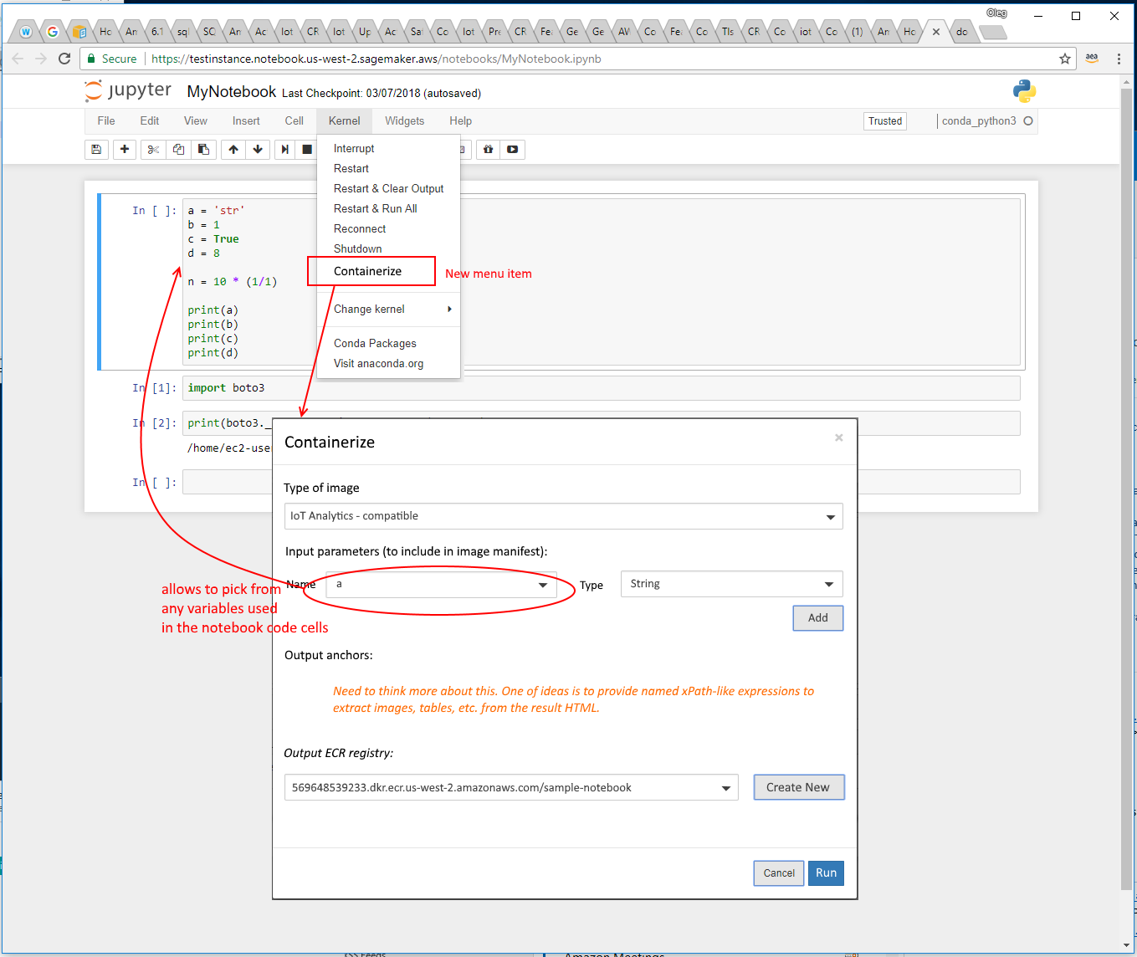
Working Backwards: Validating the UX
Notes:
So, unlike David #1, hacker extraordinaire, David #2 and his team sat down to visualize what a great user experience could look like before writing a line of code. A little bit work in, ahem, a sophisticated desktop paint application that will remain unnamed, and a few minutes later there was a tangible image of what the feature would look like in production. This is the actual first mock-up of the feature, which consisted of a menu item and a modal dialog. From that first discussion came a second, more refined design.

Slide 12
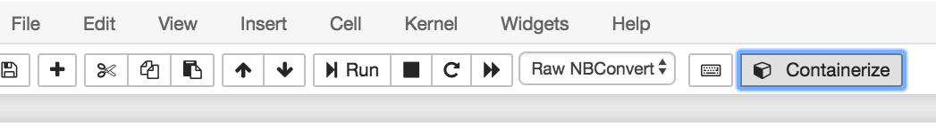
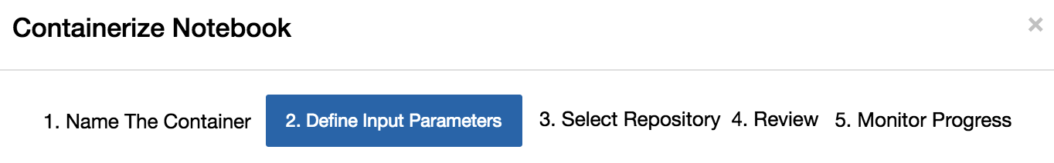
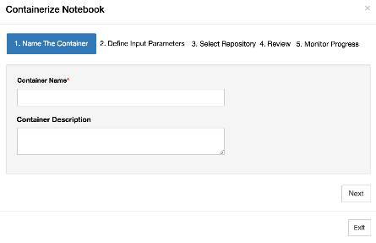
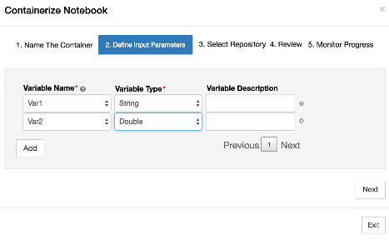
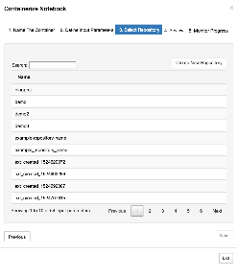
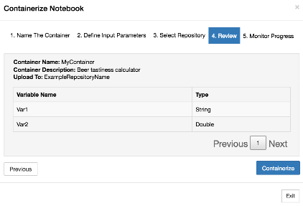
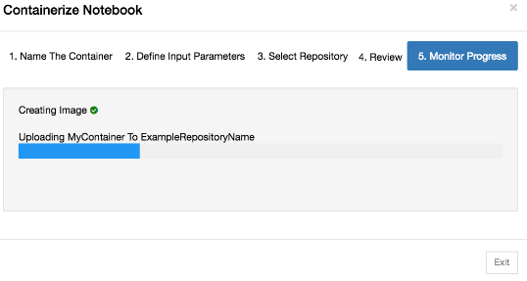
Working Backwards: Validating the UX (part 2)
Notes:
The first proposed change was to move the functionality to the toolbar, for increased visibility.
(next)
The next proposed change was to move to a step-by-step dialog which offers a more guided experience, and gives more room on the screen for (next) specifying metadata, (next) identifying notebook variables, (next) determining where the container will be stored, (next), confirm all options, (next) and providing real-time progress while the containerization process completes.

Slide 13
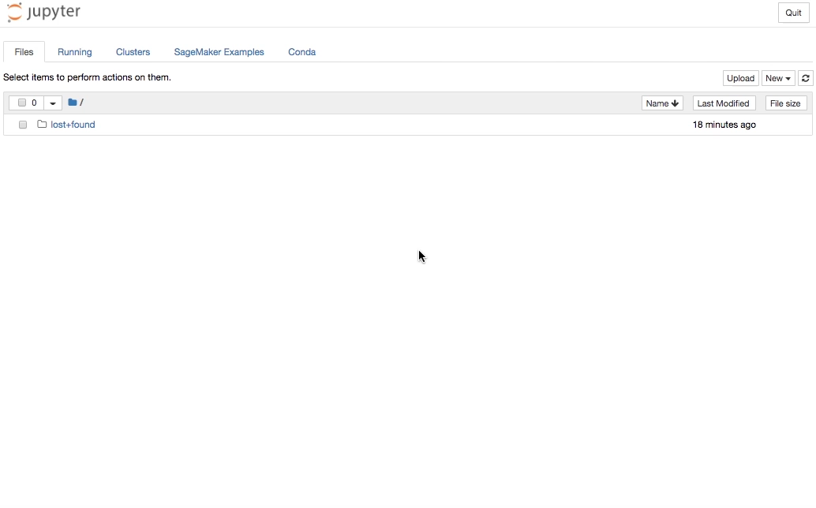
And now, a Demo…
Notes:
In fact, based on that design, and a few more nit-picks later, validated by some internal customers, that second iteration eventually became the design used in the final product. So, before I get into how it was built, let me show it to you in action.

Slide 14
High-Level – All of the Moving Parts
iota_notebook_containers Plugin
install.sh
serverextension (.py)
install_kernels.py
KernelImageCreator
ECR-Related RequestHandlers:
/create_repo
/upload_to_repo
/list_repos
AWS IoT, SageMaker Training, Your Use Case, etc.
nbextension (.js)
Notes:
Now that you see the production version of the plugin in action, let me give you an overview of all of the parts that are involved.
(next) On the client-side, everything is managed by a single module called iota_notebook_containers. AWS IoT automatically installs this module in SageMaker Notebooks when the feature is activated.
(next) The first entry point is the installation script, which has two jobs: first, it creates several new KernelSpec kernel.json files in Jupyter, so that “Containerized” versions of all of the existing kernels appear in the Jupyter UI. (next) This is all done within some Python code. The second job is to register the Jupyter extension with Jupyter, so the Containerization features are enabled.
(next) Like many Jupyter extensions, this extension is split between a JavaScript nbextension which runs in the browser, and a Python (next) serverextension that runs alongside Jupyter on the server. The nbextension contains the toolbar button registration and the wizard pages. It automatically detects whether a containerized kernel is being used or not, too.
The serverextension is comprised primarily of two parts, (next) the interactions with ECR (which is a fully-managed Docker container registry, and the (next) nuts-and-bolts which performs the kernel snapshotting – the “containerization.”
(next) Last, but certainly not least, is what happens with the containers once they’re produced. While the focus of this functionality was to use the IoT Analytics feature, the containers that are produced can be used for a variety of use cases. In other words, there isn’t anything IoT-specific which is produced – the notebook becomes the container’s entrypoint. And for the dockerheads in the room, the containers that are produced uses standard Open Container Spec annotations to store all of the metadata necessary to run the container later in your serverless environment of choice.
So, who’d like to do a couple of deep dives on a few of these components? Don’t worry, none of this will be on the test, and the source code will be available for more casual perusal after this talk.

Slide 15
Deep Dive: KernelContainerCreator
def _create(self):
dockerfile = '''
FROM amazonlinux:latest
RUN yum install -y procps
'''
mounted_volumes = {
'/home/ec2-user/anaconda3/': {
'bind': '/home/ec2-user/anaconda3/',
'mode': 'rw'
},
'/home/ec2-user/.local/share/jupyter/runtime/': {
'bind': '/home/ec2-user/.local/share/jupyter/runtime/',
'mode': 'rw'
},
'/home/ec2-user/SageMaker/': {
'bind': '/home/ec2-user/SageMaker/',
'mode': 'rw'
},
'/home/ec2-user/.aws/': {
'bind': '/home/ec2-user/.aws/',
'mode': 'rw'
}
}
self._docker_client.images.build(fileobj=BytesIO(dockerfile.encode('utf-8')), tag=self._name)
Notes:
One of the things that I mentioned about the IoT Analytics feature is that it installs a whole bunch of Jupyter kernels, essentially duplicating all of the existing KernelSpecs, but making them “containerized” versions. Much like David #1’s implementation, running the kernels within a container is important so that we have some confidence that if it runs in the container, that it will also run in the serverless environment on a schedule.
One cool thing that you might not know, is that you can programmatically create Dockerfiles in Python, using the very nice docker python library. Here’s a snippet of code that shows how we create the dockerfile for each container using some easy-to-read Python code.

Slide 16
Deep Dive: KernelContainerCreator
class ContainerizedKernelInstaller(object):
def __init__(self):
self._kernel_spec_manager = EnvironmentKernelSpecManager()
def install(self):
with TemporaryDirectory() as td:
os.chmod(td, 0o755)
for kernel_name in self._kernel_spec_manager.find_kernel_specs():
if not self._should_containerize_kernel(kernel_name):
continue
kernel_display_name = 'Containerized ' + kernel_name
with open(os.path.join(td, 'kernel.json'), 'w') as f:
kernel_json = self._get_kernel_json(kernel_name, kernel_display_name)
json.dump(kernel_json, f, sort_keys=True)
safe_name = kernel_display_name.replace(' ', '_')
self._kernel_spec_manager.install_kernel_spec(td, safe_name, prefix=sys.prefix, replace=True)
Notes:
And here’s a snippet of code that shows how easy it is to install a new kernel definition in Python code. One interesting thing to point out in this code snippet is that Amazon SageMaker uses an open-source Jupyter plugin called environment_kernels, which automatically maps the currently configured conda environments to a kernel choice in Jupyter. By re-importing the same class into our Python code, we can use the same conda-walking logic to perform the kernel duplication, as well.
Q&A: What’s the purpose of asttokens?
Q&A: Why install the kernels if you could just generate them automatically just like EnvironmentKernelSpecManager.

Slide 17
Deep Dive: KernelImageCreator
Install asttokens
Create “interim” container
Copy any detected dependencies
Copy .ipynb file
docker commit
ENTRYPOINT=
iota_run_nb.py
Notes:
OK, here’s another deep dive I thought you might find interesting. What happens after the user clicks the “Containerize” button and completes the wizard? In David #1’s version, his prototype was pretty hard to follow, but the IoT version is actually quite straightforward. Remember, the goal of this step is to produce a container from the currently running Kernel, that can be run “on its own” at a later date, including all of the code inside of the notebook being run.
(next) The first step is just a little housekeeping. At container runtime, the Python asttokens library is needed, so we just “pip install” it now.
(next) Second, we create a new, fresh Docker container that will serve as the final output.
(next) Then, we walk the entire PYTHON_PATH, and a few other things, and copy those files into the interim container.
(next) Then, we copy in the current notebook.
(next) And lastly, we copy in an entrypoint script.
(next) Now that the container is good-to-go, we call docker commit which produces a shareable, reproducible container.
Q&A: What are the “other things”?

Slide 18
Deep Dive: the ENTRYPOINT (iota_run_nb.py)
Replace Variables
Execute nbconvert
Write HTML to S3
Notes:
One more deep dive! Let’s talk briefly about what happens when the container is launched in the serverless environment that IoT provides. Previously, this container was running the Jupyter kernel while attached to the Jupyter server, so what do we need to do so it can run in a standalone, headless manner?
Well, really, not too much!
(next) The first thing that needs to happen is to update the variable values in the notebook .ipynb file. Some examples of variables being passed in at runtime would include date ranges, the names of files to process, and maybe even some hyperparameters. We try to do this replacement in an elegant way by using the asttokens library instead of performing simple string replacement in the notebook’s JSON file. This helps avoid edge cases where variable assignments appear in comments, string literals, and so forth. By using this library we have some amount of confidence that the replacement is going to work reliably. Since the docker container is not committed at the end of the run, we can just overwrite the contents of the .ipynb file.
(next) Then, we run the infamous nbconvert application. nbconvert is called directly by our Python script by importing Python modules from the nbconvert.preprocessors package. No subprocess needed! And, because of the necessary dependencies are already in the image, it runs without a hitch!
(next) Lastly, after nbconvert is complete, the HTML file that it produced is uploaded to S3 using the venerable boto3 library (boto3 is the official AWS SDK for Python, in case you’re not familiar with it.)
Q&A: Why do we output as HTML and not .ipynb? Seems like outputting as .ipynb would be more re-usable.

Slide 19
Interesting Decisions and Lessons
Frontend
  Decision: Use native UI
  TIL: Use %who_ls to get names of interactive variables
Backend
  Decision: no remote (ECR) calls from JavaScript
  TIL: Use async liberally
Notes:
There are a few more things I felt that you might find interesting would be some of the decisions that the IoT team made during its development of this Jupyter plugin, and understand some of the tradeoffs they made in the process.
(next) So, one thing the team decided very early on was that we would stick with most of the existing Jupyter frontend JS stack, including the use of bootstrap and jQuery. We did this partly to cut down on development time, but also to keep the team focused on building a natural user experience that had a very integrated feel along with the rest of Jupyter. If we, for example, introduced AWS-specific design elements, branding, and so forth, this would produce a jarring experience that would feel too messy and shoe-horned. Likewise, if the IoT team decides in the future to rebuild this functionality as a JupyterLab extension, the same philosophy will almost certainly apply – use the JupyterLab design language and UI frameworks to build the most natural experience possible.
(next) One lesson that was learnt while building the frontend happened while building the containerization wizard. What’s the most appropriate way to, from JavaScript, detect all of the possible variables in the notebook that could be replaced during a scheduled run? Doing this from JavaScript, by inspecting the cells, seemed like a serious chore, and likely to be error prone. So, instead, we actually dispatch a temporary cell to the Kernel which calls the IPython %who_ls magic, which prints all interactive variables along with their Python types – then this can easily be parsed from the JavaScript in order to display the variable table in the containerization wizard.
(next) (next) On the backend, we made the decision that all calls made to remove services, would happen exclusively from the Python code. If the JavaScript code needed access, to say Amazon ECR, it would call to the Python code, which would make the necessary calls to AWS. Aside from being a general best practice, this solved a lot of potential security issues, since we would never need to pass any AWS credentials to the user’s browser. Incidentally also made the JavaScript code more maintainable, reduced the possibility of needing to load more dependencies.
(next) One lesson learnt while building the backend was that Jupyter and Tornado like to stay unblocked! We used the Python async code liberally to make sure that Jupyter stayed unblocked – in early iterations where the containerization all occurred on the main thread, Jupyter would become unresponsive during the entire process.

Slide 20
Interesting Decisions and Lessons (contd.)
How many local Docker containers?
  Decided that we will start with a singleton container that is shared across all Kernels, for now.
  An “interim” container is used during the export process, though.
Dependencies – just snapshot the disk, or rebuild?
  Decided to rebuild a clean container with just PYTHON_PATH dependencies.
Storing annotations in the Docker Manifest
  Avoid having to build an additional metadata store by recording notebook variables directly in the Docker Manifest
  Docker CLI support for OCI annotations was just merged on July 20!
  Needed to manually apply the annotations after uploading to ECR as a workaround
Notes:
Q&A. Why asttokens instead of papermill?
Q&A. Why only capture python dependencies instead of snapshotting the disk as-is?

Slide 21
Wrapping Up
√
√
√
What is a “containerized” notebook or kernel?
What is it good for?
How does it work?
Notes:
So, that just about wraps things up for these two implementations. Taking a look back at the questions I posed at the beginning, here’s what I hope you can walk away with.
(next) One, I hope I’ve expanded your ideas on where the container boundary can go, besides just at the server level, considering the possibility of containerizing just a single notebook file, or the Ipython kernel.
(next) Two, I’ve demonstrated two different use cases: offloading experiment work to improve iteration time, and packaging a notebook for execution as a job. Take a moment to think of other use cases that might apply to your use of Jupyter.
(next) Three, we’ve done a deep dive on how this is accomplished. Armed with some basic knowledge of how Jupyter surfaces its kernels, and how docker containers are launched, it’s reasonably straightforward to modify this approach based on your specific environment.
And lastly, I’m inviting you to dive in right away, and try this on your own.

Slide 22
How do I get started?
Download some of our sample code…
Try out the IoT containerization plugin yourself…
  INSIDER TIP! You don’t need to use IoT to install this plugin!
  INSIDER TIP #2! This plugin might work in your Jupyter installation!
Try to implement your own containerized notebooks, and tell us how you did it!
Notes:
I’m happy to let you know that all of the code, sans some of David #1’s hackery, is open source for exploration and contributions, and just a reminder that this functionality is available starting today. We’ve really just scratched the surface of what is possible with containerized notebooks and kernels, but we’re excited about some of the progress we’ve made and are really looking forward to diving in further.

Slide 23
Thank you!
Looking forward to your contributions!
  https://github.com/awslabs/aws-iot-analytics-notebook-containers/
…and your questions!
  https://stackoverflow.com/questions/tagged/amazon-sagemaker
  https://stackoverflow.com/questions/tagged/aws-iot

